Slide 1

The Technology Value Stream
Truman Forey
5/30/2025
CSD 380

Slide 2
Intro – What is the ‘Technology Value Stream’?
A ‘technology value stream’ is the process required to turn a hypothetical request into a service or feature that provides value.
Can be applied to a variety of things – from a process as huge as creating an entire enterprise infrastructure to an action as small as troubleshooting a minor bug.
Since value is only created by providing services or features, it’s important to ensure that deployments are quick and don’t cause any disruptions.

Slide 3
General Principles of Tech Value Streams
Technology Value Streams are built on the same values of General Value Streams.
These include:
Minimizing the time between a request being made and being fulfilled (aka lead time).
Making sure the goal/intended direction is clear and well-communicated.
An even distribution of work across all teams involved.
Ensuring defects are not passed to downstream work centers.
Constantly optimizing systems towards global goals.

Slide 4
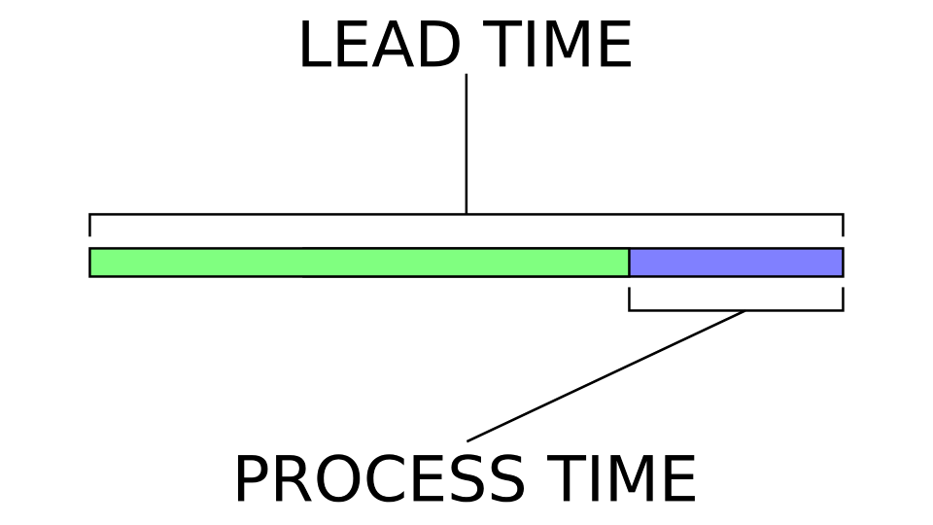
Lead Time vs Processing Time
Lead Time
Processing Time
What the customer(s) experience. Measures the time between a request is made and when the request is completed.
Shortening lead time is usually prioritized in order to improve the customer’s experience.
What the developers experience. Measures the time between the start of work on a request and when the work is completed.
The ratio of lead time to processing time is a strong metric of efficiency, since requests generally shouldn’t be in the queue for longer than it takes to start work on it.

Slide 5
Common Scenario: Month-Long Lead Times
Many organizations can find themselves in situations where it can take months in order to complete requests.
Can be caused by a variety of issues:
Inflexible development processes and/or poor testing environments.
Complicated systems of bureaucracy needed to start or finish work.
Completely unpredictable issues, like system outages or employees getting sick.
This situation is bad for everyone: it puts unnecessary work and stress on developers while also providing a negative customer experience.

Slide 6
Ideal Scenario: Minute-Long Lead Times
In an ideal world, developers are able to act quickly in order to push solutions within a matter of minutes or hours.
This can be done by utilizing automated systems, modular system architecture, and small, highly autonomous teams of developers.
This also helps make sure that failures are small-scale and don’t cause severe disruptions.
While we should try to reach this state of efficiency, it’s also an idealized circumstance that is unlikely to be fully reached or sustainable.

Slide 7
Conclusion
Technology Value Streams are all about the process it takes to deliver a service or product.
Lowering Lean Times are the top priority to raise efficiency, while Processing Times are a good metric to reach that goal.
It’s critical to strive for highly efficient processes while also accepting that obstacles are likely to block those ambitions.

Slide 8
Sources Cited
Kim, Humble, Debois, & Willis. DevOps Handbook, 2nd Edition. ITRev.
https://insights.sei.cmu.edu/blog/taking-devsecops-to-the-next-level-with-value-stream-mapping/

